Slide 1



INSURANCE FRAUD DETECTION USING
MACHINE LEARNING
Project Hand-out, Faculty Development Program – NaanMudhalvan
SmartInternz
www.smartinternz.com

Slide 2
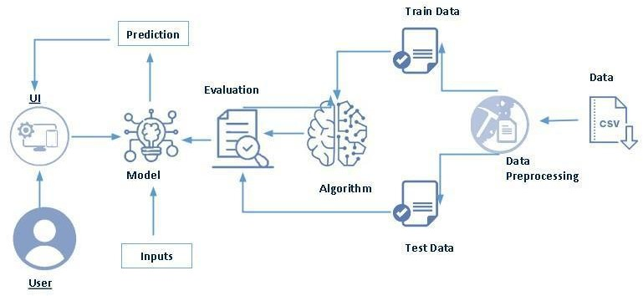
Insurance Fraud Detection Using Machine Learning
Insurance are claimed in order to get a relief amount for any damage cause. Insurance is a means of protection from financial loss , but now-a-days Many people are claiming the Insurance by fraud claims. It can be called as a scam. It is called as fraud claim when a claimant attempts to obtain some benefit or advantage they are not entitled to, or when an insurer knowingly denies some benefit that is due.
These type of Insurance claims cause loss to the company. So, It is necessary to detect the claims which are fraud. The number of cases of insurance fraud that are detected is much lower than the number of acts that are actually committed. So the main purpose of the Insurance Fraud Detection system is to predict the Insurance claim is a Fraud or Legal Claim based on the different appeals and parameters.
Technical Architecture:
www.smartinternz.com

Slide 3
Project Flow:
User interacts with the UI to enter the input.
Entered input is analysed by the model which is integrated.
Once model analyses the input the prediction is showcased on the UI
To accomplish this, we have to complete all the activities listed below,
Define Problem / Problem Understanding
Specify the business problem
Business requirements
Literature Survey
Social or Business Impact.
Data Collection & Preparation
Collect the dataset
Data Preparation
Exploratory Data Analysis
Descriptive statistical
Visual Analysis
Model Building
Training the model in multiple algorithms
Testing the model
Performance Testing & Hyperparameter Tuning
Testing model with multiple evaluation metrics
Comparing model accuracy before & after applying hyperparameter tuning
Model Deployment
Save the best model
Integrate with Web Framework
Project Demonstration & Documentation
Record explanation Video for project end to end solution
Project Documentation-Step by step project development procedure
www.smartinternz.com

Slide 4
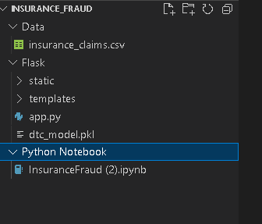
Prior Knowledge:
You must have prior knowledge of following topics to complete this project.
ML Concepts
Supervised learning: https://www.javatpoint.com/supervised-machine-learning
Unsupervised learning: https://www.javatpoint.com/unsupervised-machine-learning
Decision tree: https://www.javatpoint.com/machine-learning-decision-tree-classification- algorithm
Random forest: https://www.javatpoint.com/machine-learning-random-forest-algorithm
KNN: https://www.javatpoint.com/k-nearest-neighbor-algorithm-for-machine-learning
Xgboost: https://www.analyticsvidhya.com/blog/2018/09/an-end-to-end-guide-to- understand-the-math-behind-xgboost/
Evaluation metrics: https://www.analyticsvidhya.com/blog/2019/08/11-important-model- evaluation-error-metrics/
Flask Basics : https://www.youtube.com/watch?v=lj4I_CvBnt0
Project Structure:
Create the Project folder which contains files as shown below
We are building a flask application which needs HTML pages stored in the templates folder and a python script app.py for scripting.
Dtc_model.pkl is our saved model. Further we will use this model for flask integration.
Data Folder contains the Dataset used
The Notebook file contains procedure for building th model.
www.smartinternz.com

Slide 5
Milestone 1: Define Problem / Problem Understanding
Activity 1: Specify the business problem
Refer Project Description
Activity 2: Business requirements
A drug classification project can have a variety of business requirements, depending on the specific goals and objectives of the project. Some potential requirements may include:
Accurate and up-to-date information: The project should use the most recent and reliable data to classify drugs, in order to ensure that the information is accurate and relevant to current medical practices.
Flexibility: The classification system should be flexible and able to adapt to new drugs and changing information as it becomes available.
Compliance: The project should comply with all relevant laws and regulations, such as FDA guidelines for classifying drugs.
User-friendly interface: The classification system should be easy to use and understand for both medical professionals and patients.
Activity 3: Literature Survey (Student Will Write)
A literature survey for a drug classification project would involve researching and reviewing existing studies, articles, and other publications on the topic of drug classification. The survey would aim to gather information on current classification systems, their strengths and weaknesses, and any gaps in knowledge that the project could address. The literature survey would also look at the methods and techniques used in previous drug classification projects, and any relevant data or findings that could inform the design and implementation of the current project.
Activity 4: Social or Business Impact.
Social Impact :- Improved patient care: By providing accurate and up-to-date information on drugs, a drug classification project can help healthcare professionals make more informed decisions about treatment options, leading to improved patient care.
Business Model/Impact :- New drug development: By providing information on the properties and interactions of different drugs, a drug classification project can assist in the development of new treatments and therapies.
www.smartinternz.com

Slide 6
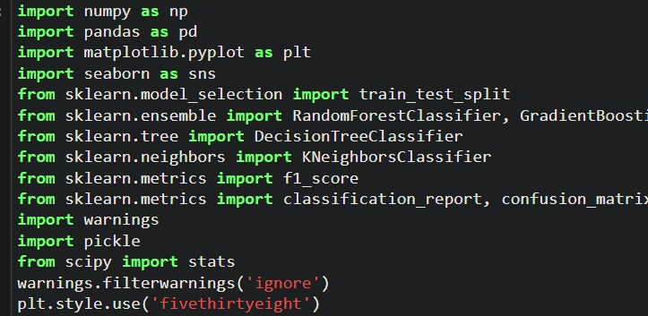
Milestone 2: Data Collection & Preparation
ML depends heavily on data. It is the most crucial aspect that makes algorithm training possible. So, this section allows you to download the required dataset.
Activity 1: Collect the dataset
There are many popular open sources for collecting the data. Eg: kaggle.com, UCI repository, etc.
In this project we have used .csv data. This data is downloaded from kaggle.com. Please refer to the link given below to download the dataset.
Link: https://www.kaggle.com/datasets/buntyshah/auto-insurance-claims-data
As the dataset is downloaded. Let us read and understand the data properly with the help of some visualisation techniques and some analysing techniques.
Note: There are a number of techniques for understanding the data. But here we have used some of it. In an additional way, you can use multiple techniques.
Activity 1.1: Importing the libraries
Import the necessary libraries as shown in the image. (optional) Here we have used visualisation style as fivethirtyeight.
Activity 1.2: Read the Dataset
Our dataset format might be in .csv, excel files, .txt, .json, etc. We can read the dataset with the help of pandas.
In pandas we have a function called read_csv() to read the dataset. As a parameter we have to give the directory of the csv file.
www.smartinternz.com

Slide 7
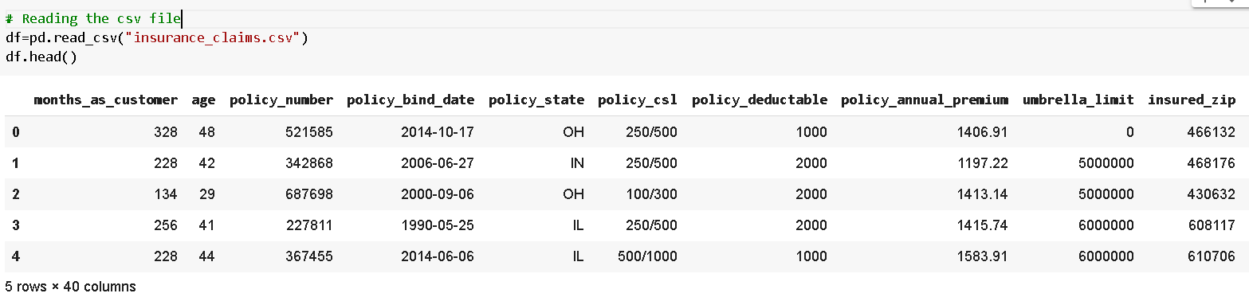
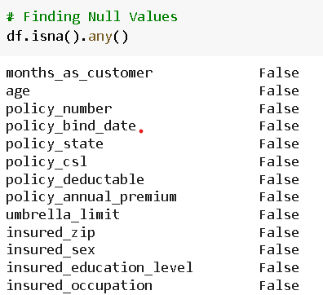
For checking the null values, df.isna().any( ) function is used. To sum those null values we use .sum() function. From the below image we found that there are no null values present in our dataset. So we can skip handling the missing values step.
Activity 2: Data Preparation
As we have understood how the data is, let's pre-process the collected data.
The download data set is not suitable for training the machine learning model as it might have so much randomness so we need to clean the dataset properly in order to fetch good results. This activity includes the following steps.
Handling missing values
Handling Outliers
Note: These are the general steps of pre-processing the data before using it for machine learning. Depending on the condition of your dataset, you may or may not have to go through all these steps.
Activity 2.1: Handling missing values
For checking the null values, df.isna().any( ) function is used. To sum those null values we use .sum() function. From the below image we found that there are no null values present in our dataset. So we can skip handling the missing values step.
www.smartinternz.com

Slide 8
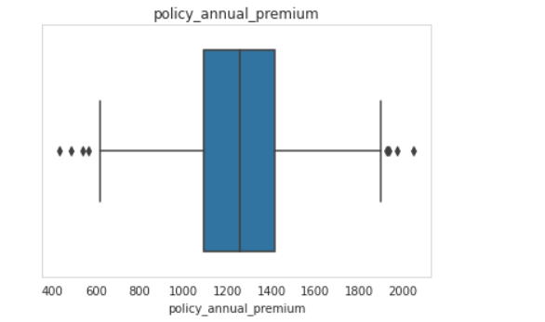
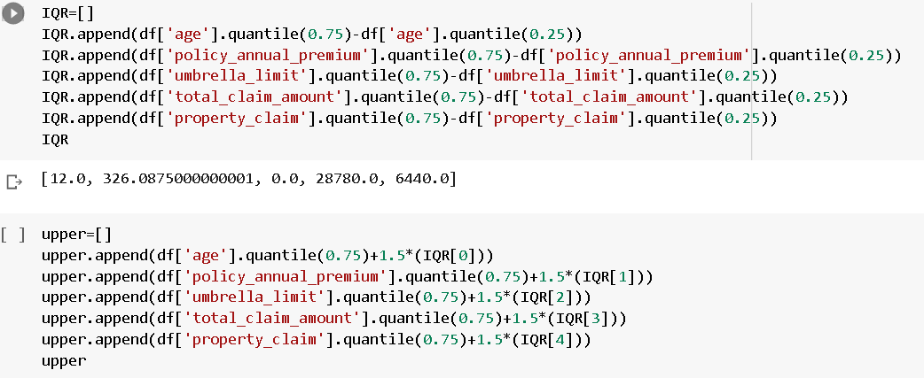
Activity 2.2: Handling Outliers
With the help of boxplot, outliers are visualized. And here we are going to find upper bound and lower bound of policy_annual_premium feature with some mathematical formula.
From the below diagram, we could visualize that policy_annual_premium feature has outliers. Boxplot from seaborn library is used here.
To find upper bound we have to multiply IQR (Interquartile range) with 1.5 and add it with 3rd quantile. To find lower bound instead of adding, subtract it with 1st quantile. Take image attached below as your reference.
www.smartinternz.com

Slide 9
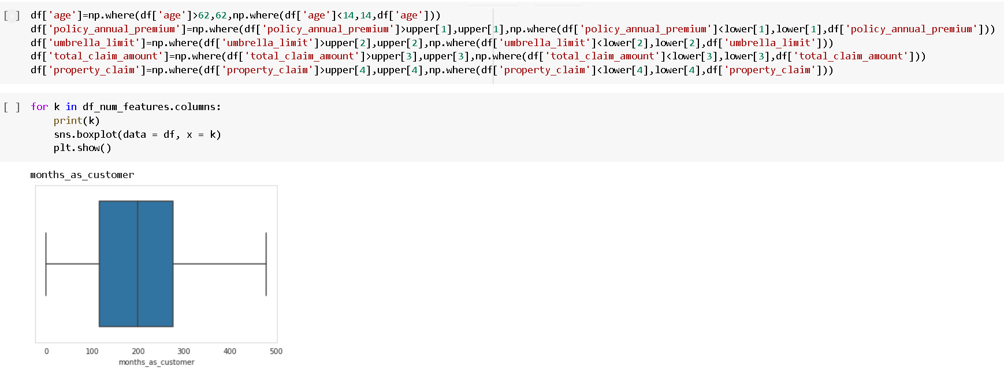
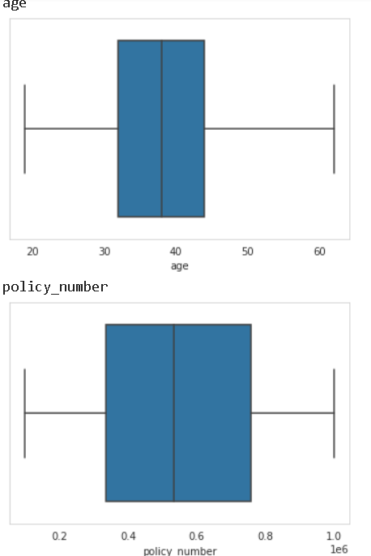
To handle the outliers transformation technique is used. Here log transformation is used. We have created a function to visualize the distribution and probability plot of policy_annual_premium feature.
www.smartinternz.com

Slide 10
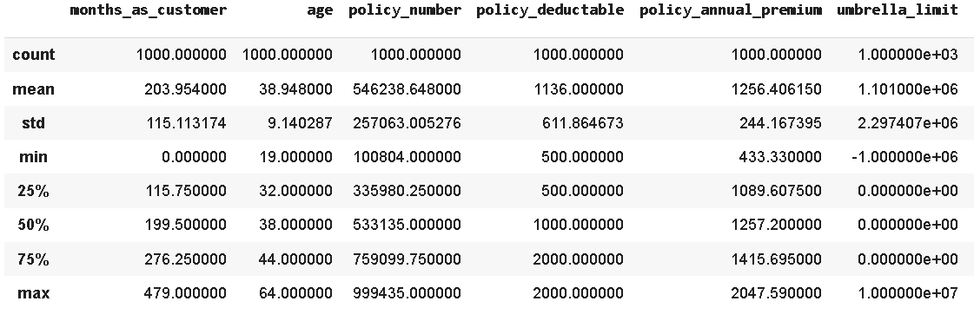
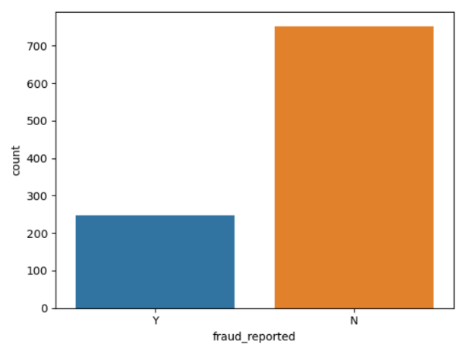
Milestone 3: Exploratory Data Analysis
Activity 1: Descriptive statistical
Descriptive analysis is to study the basic features of data with the statistical process. Here pandas has a worthy function called describe. With this describe function we can understand the unique, top and frequent values of categorical features. And we can find mean, std, min, max and percentile values of continuous features.
Activity 2: Visual analysis
Visual analysis is the process of using visual representations, such as charts, plots, and graphs, to explore and understand data. It is a way to quickly identify patterns, trends, and outliers in the data, which can help to gain insights and make informed decisions.
Activity 2.1: Univariate analysis
In simple words, univariate analysis is understanding the data with single feature. Here we have displayed two different graphs such as Piechart and countplot.
Seaborn package provides a wonderful function countplot. It is more useful for categorical features. With the help of countplot, we can Number of unique values in the feature. From the countplot we can say that there are only 247 fraud cases reported in 1000 insurance claims.
www.smartinternz.com

Slide 11
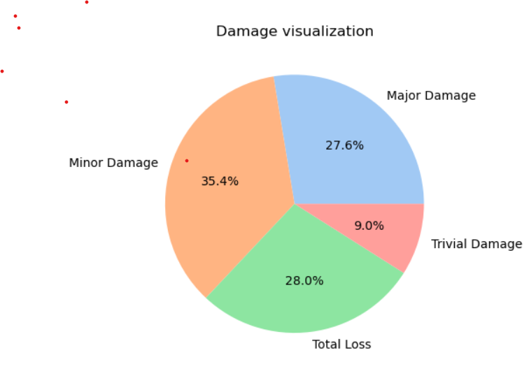
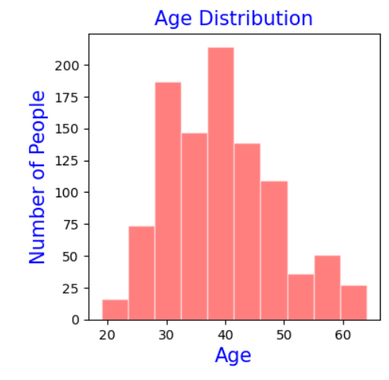
Pie chart describes the composition of Incident Severity Feature. It describes the 35.4% of Minor damage cases and almost equal composition of Major Damage and Total Loss and only 9% of Trivial Damage.
From the below histogram we can say that ‘age’ Feature is almost Normally distributed. Majority of Insurance claims are of age 30 to 50.
Activity 2.2: Bivariate analysis
To find the relation between two features we use bivariate analysis. Here we can used barplot.
www.smartinternz.com

Slide 12
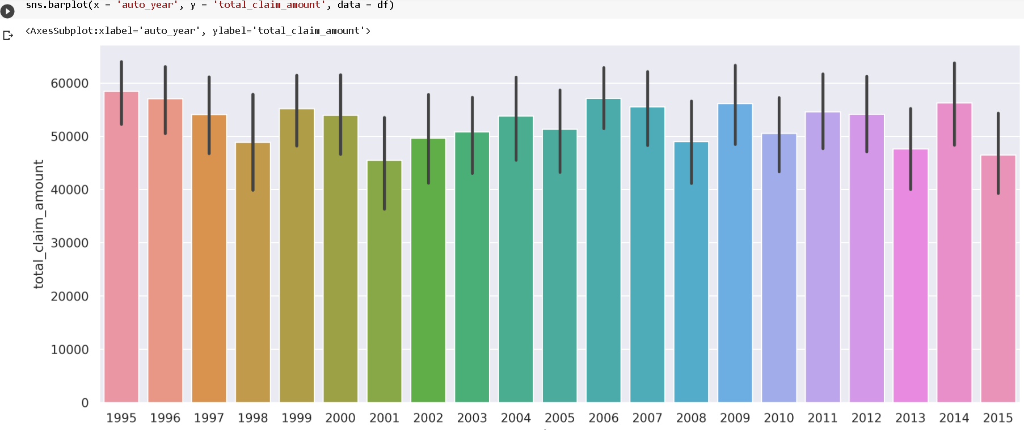
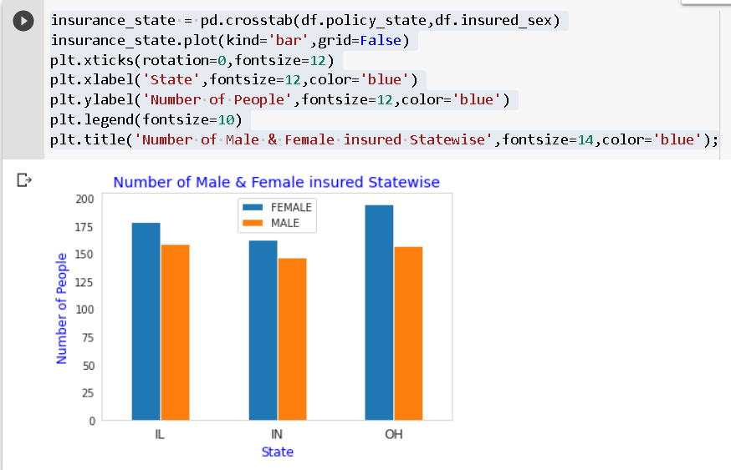
Barplot is used here. As a 1st parameter we are passing auto_year and as a 2nd parameter we are passing total_claim_amount.
From the below plot you can understand that distribution of total_claim_amount on auto_year.
The Most of the claim amounts are of 50,000 to 60,000 from the years 1995 to 2015.
From the below barplot we can able to figure that Females are more Insured than Males across the different states.
Activity 2.3: Multivariate analysis
In simple words, multivariate analysis is to find the relation between multiple features. Here we have used heatmap from seaborn package.
www.smartinternz.com

Slide 13
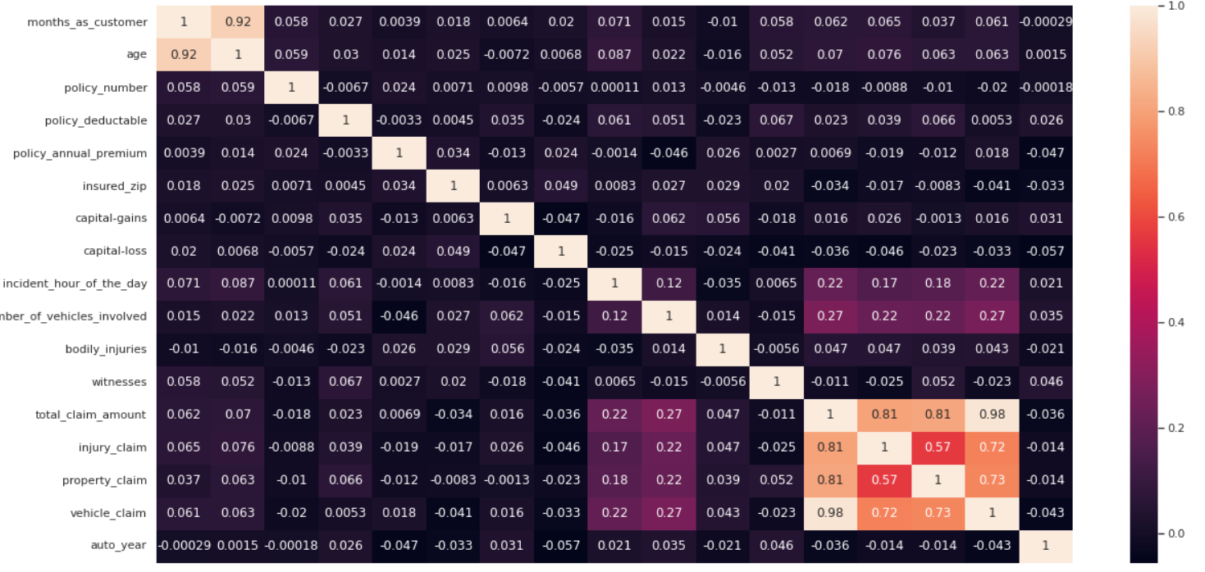
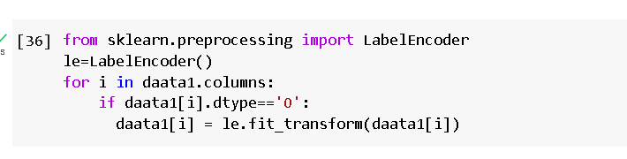
From the below image, we came to a conclusion that there are some features which are highly correlated.
The correlation between the months_as_customer and age is highly correlated with 0.92 value .
The features like total_claim_amount,injury_claim, property_claim, vehicle_claim are also highly correlated.
These Highly correlated features should be dropped.
Encoding the Categorical Features:
The categorical Features are can’t be passed directly to the Machine Learning Model. So we convert them into Numerical data based on their order. This Technique is called Encoding.
Here we are importing Label Encoder from the Sklearn Library.
Here we are applying fit_transform to transform the categorical features to numerical features.
www.smartinternz.com

Slide 14
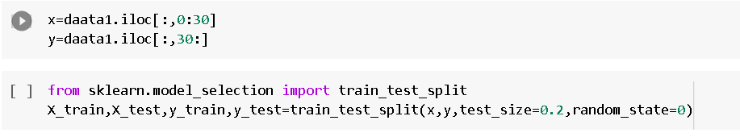
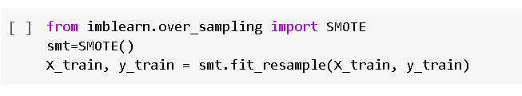
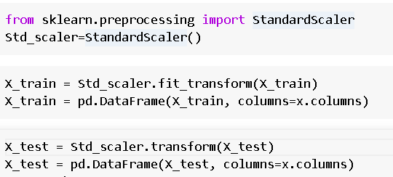
Splitting data into train and test
Now let’s split the Dataset into train and test sets. First split the dataset into x and y and then split the data set
Here x and y variables are created. On x variable, df is passed with dropping the target variable. And on y target variable is passed. For splitting training and testing data we are using train_test_split() function from sklearn. As parameters, we are passing x, y, test_size, random_state.
Handling Imbalanced dataset
Imbalanced data is a common problem in machine learning and data analysis, where the number of observations in one class is significantly higher or lower than the other class. Handling imbalanced data is important to ensure that the model is not biased towards the majority class and can accurately predict the minority class.
Here we are using SMOTE Technique.
Scaling
Scaling is a technique used to transform the values of a dataset to a similar scale to improve the performance of machine learning algorithms. Scaling is important because many machine learning algorithms are sensitive to the scale of the input features.
Here we are using Standard Scaler.
This scales the data to have a mean of 0 and a standard deviation of 1. The formula is given by:
X_scaled = (X - X_mean) / X_std

Slide 15
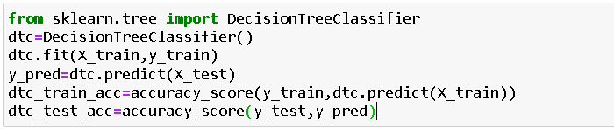
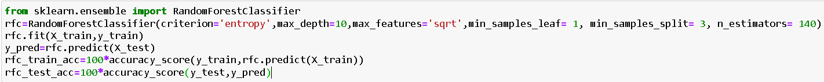
Milestone 4: Model Building
Activity 1: Training the model in multiple algorithms
Now our data is cleaned and it’s time to build the model. We can train our data on different algorithms. For this project we are applying three classification algorithms. The best model is saved based on its performance.
Activity 1.1: Decision tree model
First Decision Tree is imported from sklearn Library then DecisionTreeClassifier algorithm is initialised and training data is passed to the model with the .fit() function. Test data is predicted with .predict() function and saved in a new variable. We can find the Train and Test accuracy by X_train and X_test.
Activity 1.2: Random forest model
First Random Forest Model is imported from sklearn Library then RandomForestClassifier algorithm is initialised and training data is passed to the model with .fit() function. Test data is predicted with .predict() function and saved in a new variable. We can find the Train and Test accuracy by X_train and X_test.
www.smartinternz.com

Slide 16
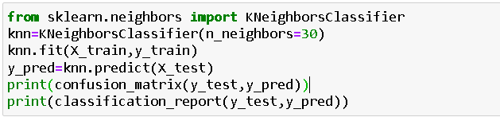
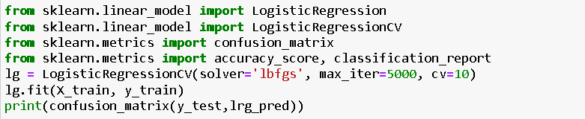
Activity 1.3: KNN model
KNN Model is imported from sklearn Library then KNeighborsClassifier algorithm is initialised and training data is passed to the model with .fit() function. Test data is predicted with .predict() function and saved in new variable. For evaluating the model, confusion matrix and classification report is done.
Activity 1.4: Logistic Regression model
Logistic Regression Model is imported from sklearn Library then Logistic Regression algorithm is initialised and training data is passed to the model with .fit() function. Test data is predicted with .predict() function and saved in new variable. For evaluating the model, confusion matrix is done.
www.smartinternz.com

Slide 17
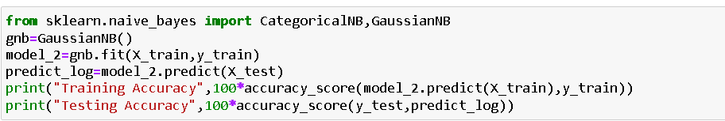
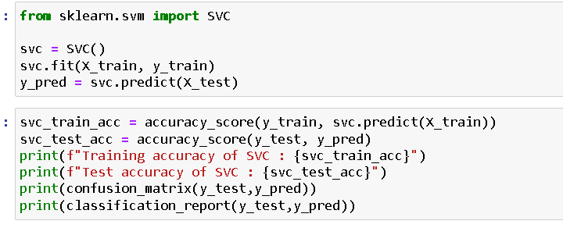
Activity 1.5: Naïve Bayes model
Naïve Bayes Model is imported from sklearn Library then Naïve Bayes algorithm is initialised and training data is passed to the model with .fit() function. Test data is predicted with .predict() function and saved in new variable. We can find the Train and Test accuracy by X_train and X_test.
Activity 1.6: SVM model
SVM Model is imported from sklearn Library then SVM algorithm is initialized and training data is passed to the model with .fit() function. Test data is predicted with .predict() function and saved in new variable. For evaluating the model, confusion matrix and classification report is done.
Activity 2: Testing the model
Here we have tested with Decision Tree algorithm. You can test with all algorithm. With the help of predict() function.
www.smartinternz.com

Slide 18
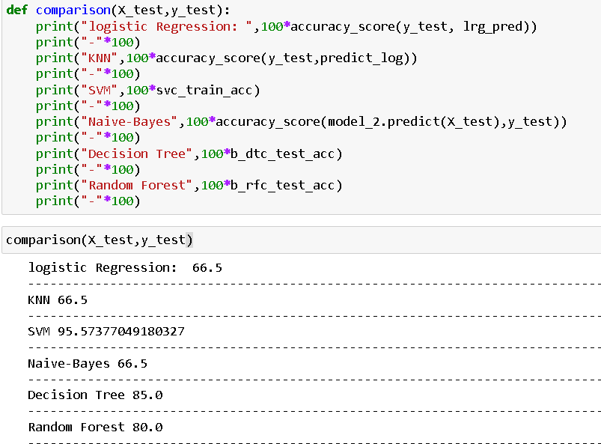
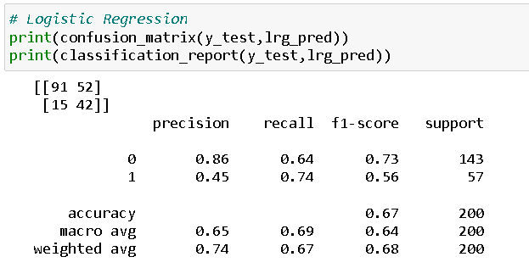
Milestone 5: Performance Testing & Hyperparameter Tuning
Activity 1: Testing model with multiple evaluation metrics
Multiple evaluation metrics means evaluating the model's performance on a test set using different performance measures. This can provide a more comprehensive understanding of the model's strengths and weaknesses. We are using evaluation metrics for classification tasks including accuracy, precision, recall, support and F1-score.
Activity 1.1: Compare the model
For comparing the above four models, the compareModel function is defined.
www.smartinternz.com

Slide 19
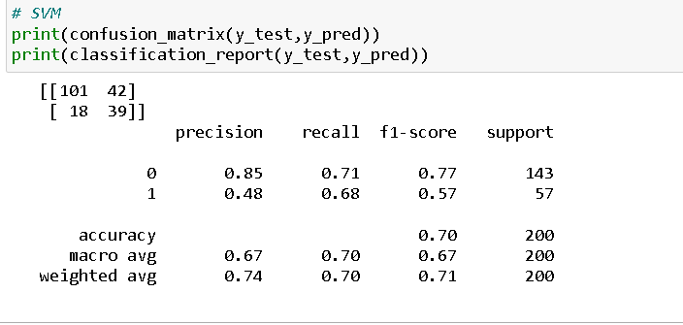
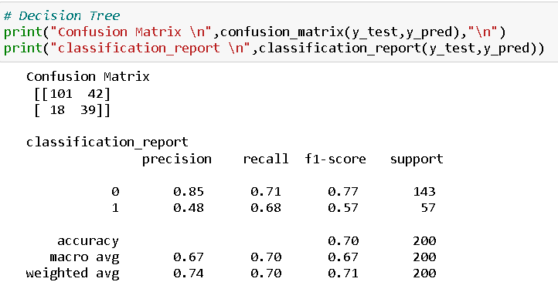
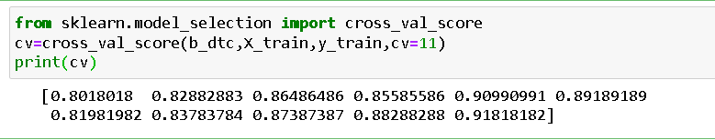
After calling the function, the results of models are displayed as output. From the above models Decision Tree is performing well.
Activity 2: Comparing model accuracy before & after applying hyperparameter tuning (Hyperparameter tuning is optional. For this project it is not required.)
Evaluating performance of the model From sklearn, cross_val_score is used to evaluate the score of the model. On the parameters, we have given rf (model name), x, y, cv (as 5 folds). Our model is performing well.
Note: To understand cross validation, refer to this link
www.smartinternz.com

Slide 20

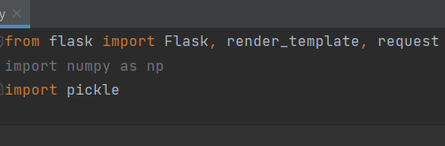
Milestone 6: Model Deployment
Activity 1: Save the best model
Saving the best model after comparing its performance using different evaluation metrics means selecting the model with the highest performance.This can be useful in avoiding the need to retrain the model every time it is needed and also to be able to use it in the future.
Activity 2: Integrate with Web Framework
In this section, we will be building a web application that is integrated to the model we built. A UI is provided for the uses where he has to enter the values for predictions. The enter values are given to the saved model and prediction is showcased on the UI.
This section has the following tasks
Building HTML Pages
Building server-side script
Run the web application
Activity 2.1: Building Html Page:
For this project create HTML file namely
index.html
and save them in the templates folder. Refer this link for templates.
Activity 2.2: Build Python code:
Import the libraries
Load the saved model. Importing the flask module in the project is mandatory. An object of Flask class is our WSGI application. Flask constructor takes the name of the current module ( name ) as argument.
www.smartinternz.com

Slide 21


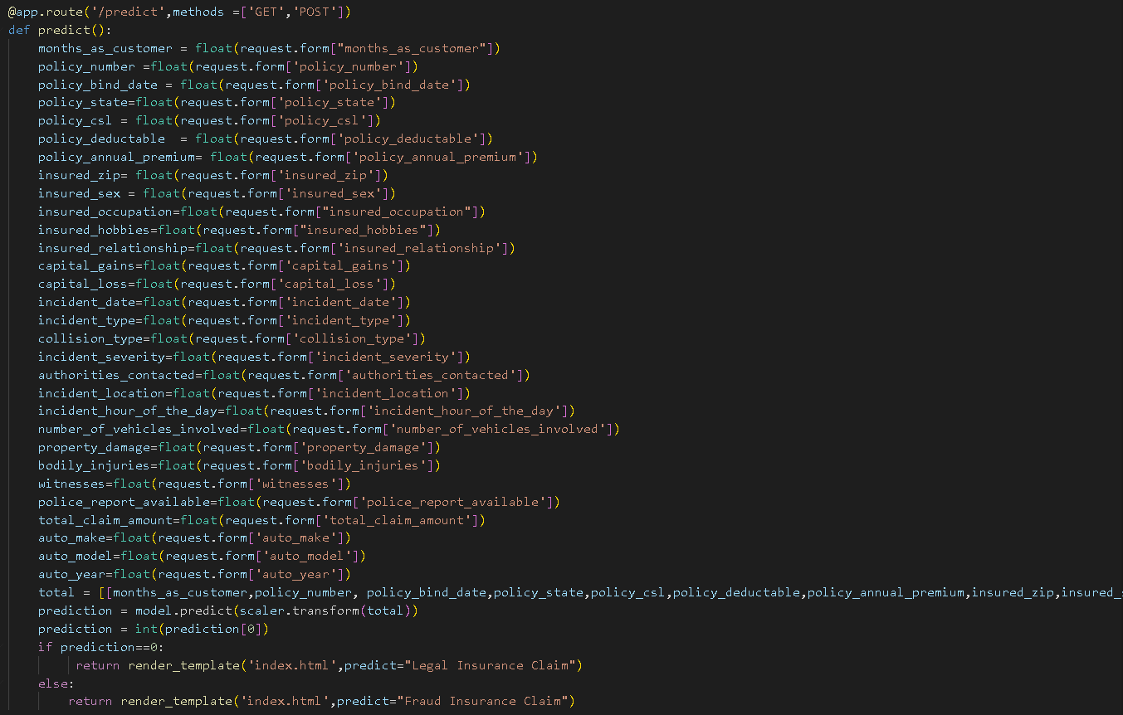
Render HTML page:
Here we will be using a declared constructor to route to the HTML page which we have created earlier.
In the above example, ‘/’ URL is bound with the index.html function. Hence, when the home page of the web server is opened in the browser, the html page will be rendered. Whenever you enter the values from the html page the values can be retrieved using POST Method.
Retrieves the value from UI:
www.smartinternz.com

Slide 22

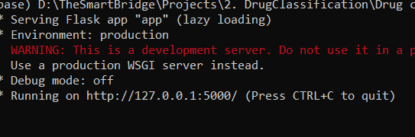
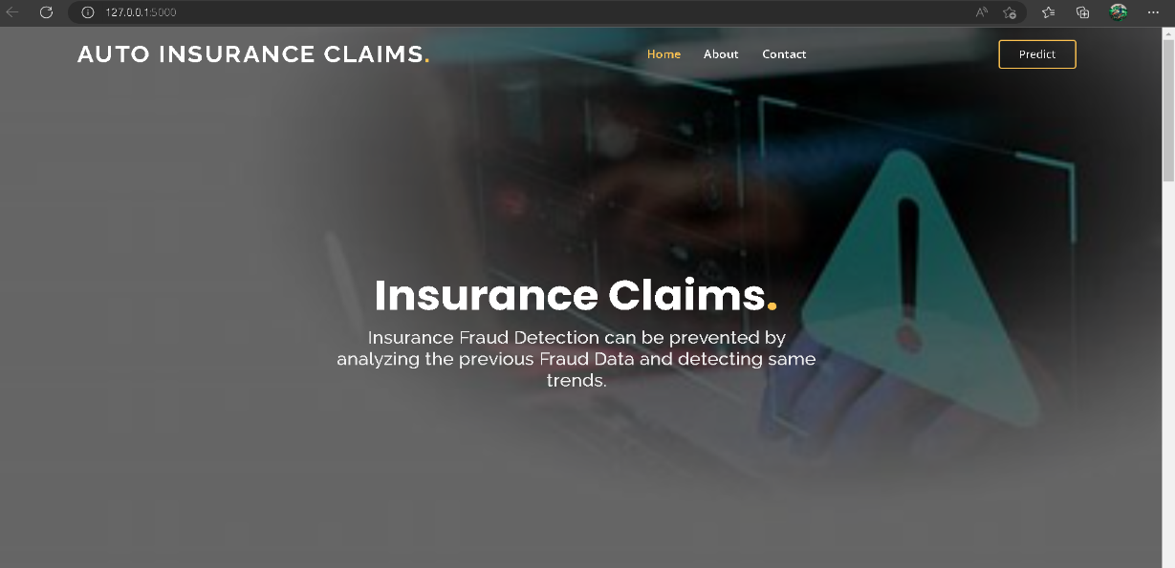
Here we are routing our app to predict() function. This function retrieves all the values from the HTML page using Post request. That is stored in an array. This array is passed to the model.predict() function. This function returns the prediction. And this prediction value will be rendered to the text that we have mentioned in the submit.html page earlier.
Main Function:
Activity 2.3: Run the web application
Open anaconda prompt from the start menu
Navigate to the folder where your python script is.
Now type “python app.py” command
Navigate to the localhost where you can view your web page.
Click on the predict button from the top left corner, enter the inputs, click on the submit button, and see the result/prediction on the web.
Now,Go the web browser and write the localhost url (http://127.0.0.1:5000) to get the below result
www.smartinternz.com

Slide 23
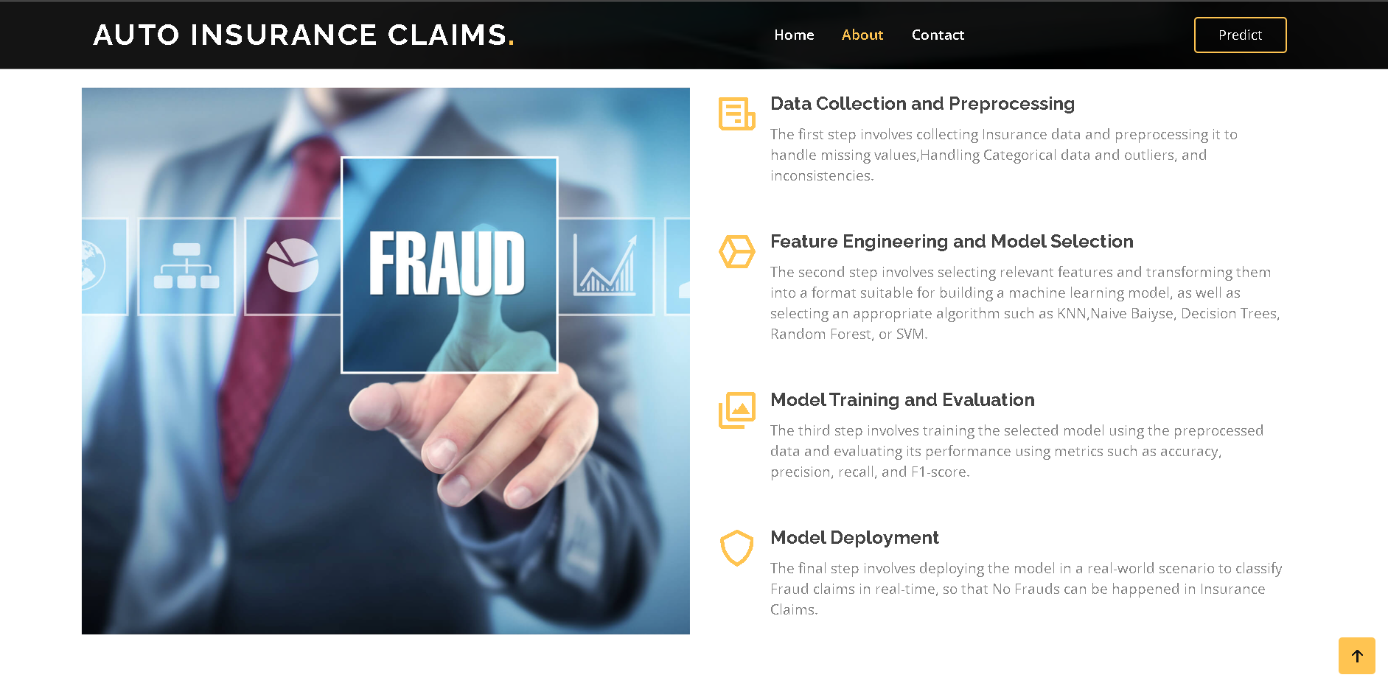
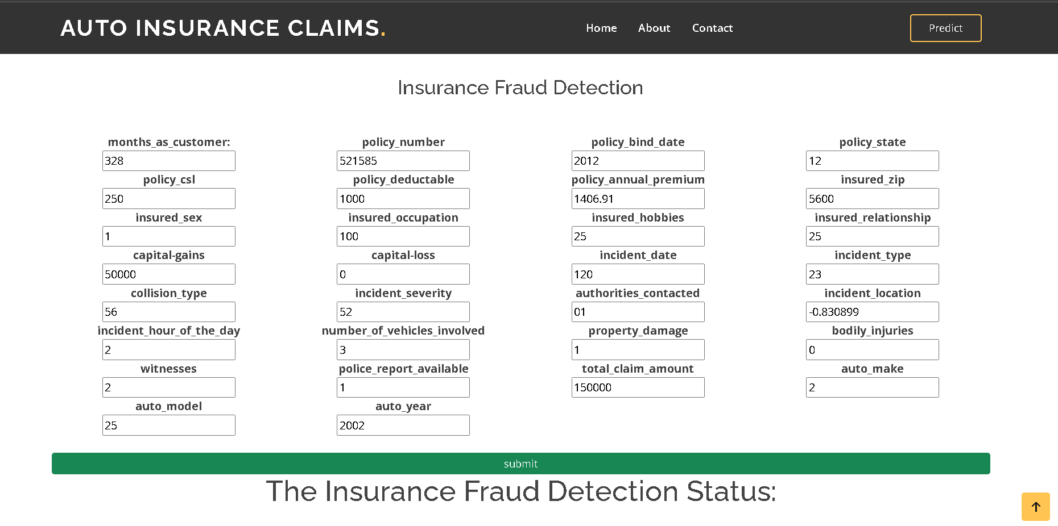
www.smartinternz.com

Slide 24
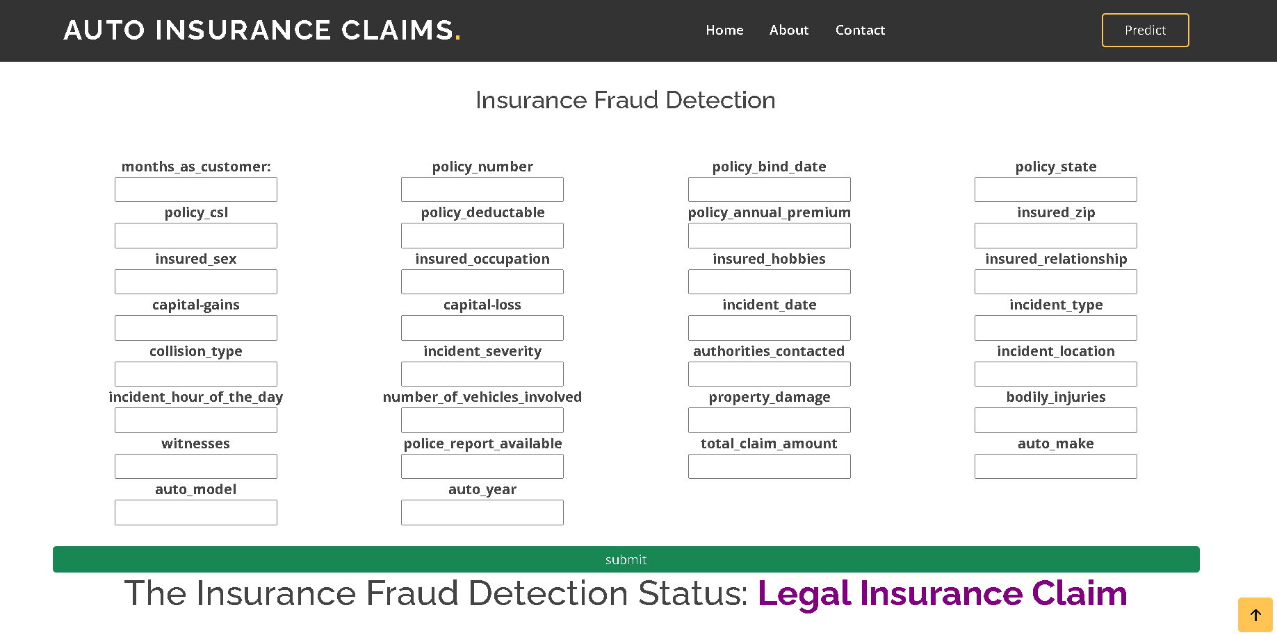
Milestone 7: Project Demonstration & Documentation
Below mentioned deliverables to be submitted along with other deliverables
Activity 1:- Record explanation Video for project end to end solution
Activity 2:- Project Documentation-Step by step project development procedure
Create document as per the template provided
www.smartinternz.com

